Slide 1
Hotel Reservations
Presented by Aya Ahmed

Slide 2

Overview of Hotel Reservations Data
Booking_ID: A unique identifier for each hotel reservation.
no_of_adults: The number of adults in the reservation.
no_of_children: The number of children in the reservation.
no_of_weekend_nights: The number of nights in the reservation that fall on
weekends.
no_of_week_nights: The number of nights in the reservation that fall on
weekdays.
type_of_meal_plan: The meal plan chosen by the guests.
room_type_reserved: The type of room reserved by the guests.
lead_time: The number of days between booking and arrival.
arrival_date: The date of arrival.
market_segment_type: The market segment to which the reservation
belongs.
avg_price_per_room: The average price per room in the reservation.
booking_status: The status of the booking.

Slide 3
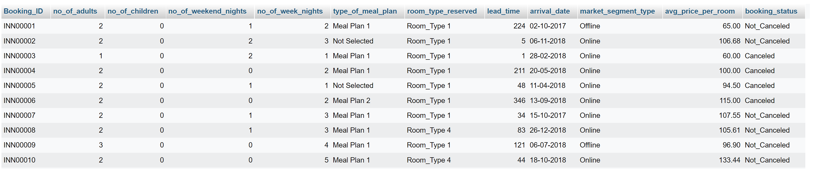
Overview of Hotel Reservations Data

Slide 4
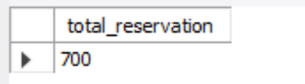
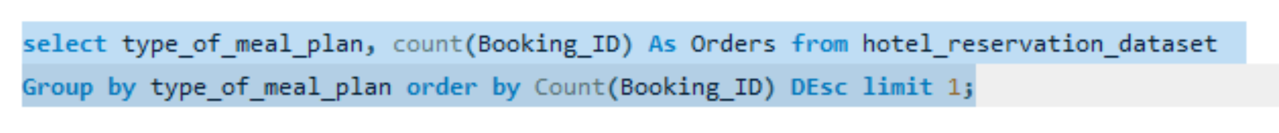
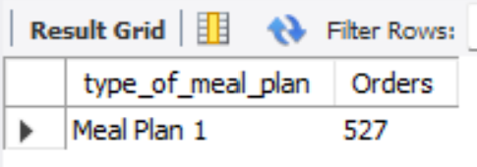
1. What is the total number of reservations in the dataset?
2. Which meal plan is the most popular among guests?

Slide 5
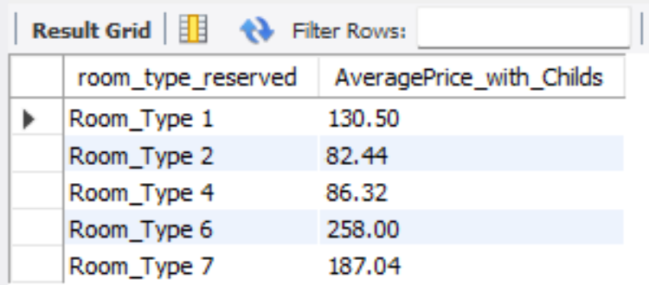
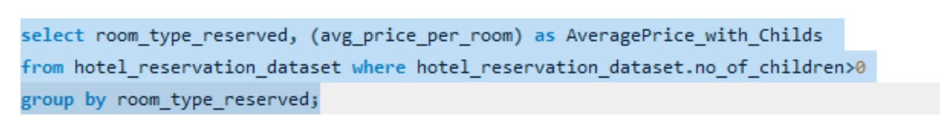
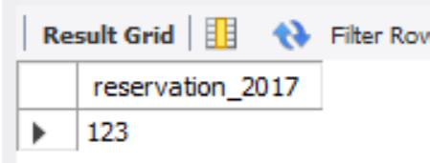
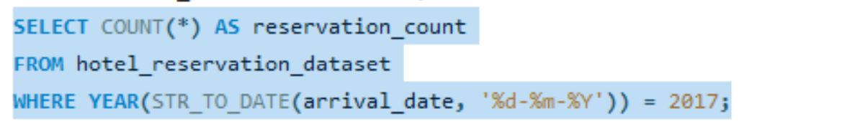
3. What is the average price per room for reservations involving children?
4. How many reservations were made for the year 20XX (replace XX with the desired year)?
(Let the desired year be 2017)

Slide 6
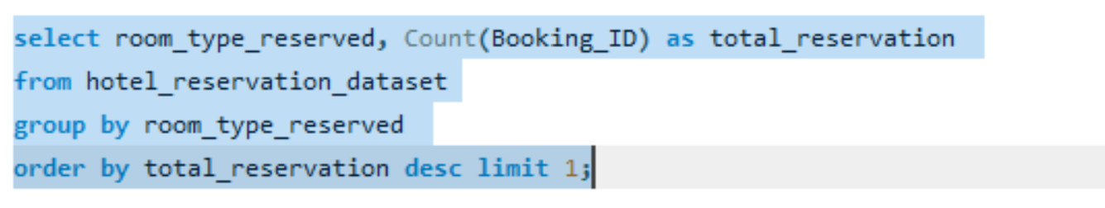
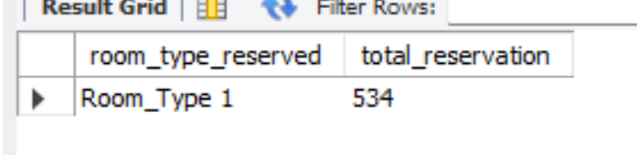
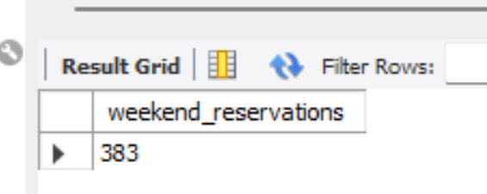
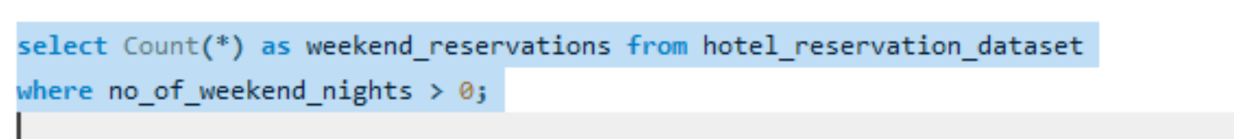
5. What is the most commonly booked room type?
6. How many reservations fall on a weekend (no_of_weekend_nights > 0)?

Slide 7
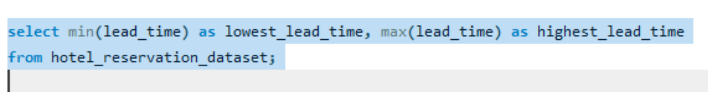
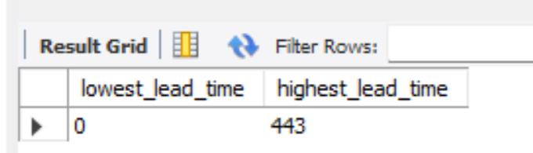
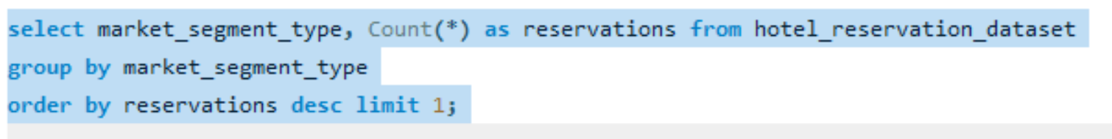
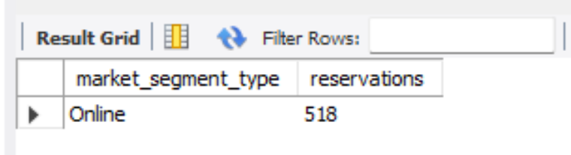
7. What is the highest and lowest lead time for reservations?
8. What is the most common market segment type for reservations?

Slide 8
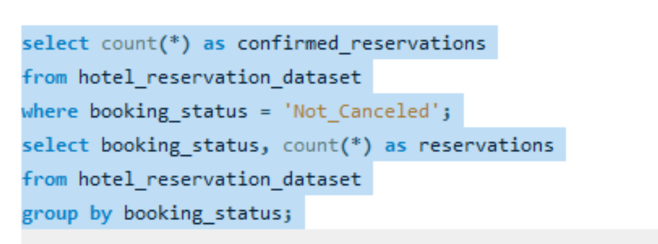
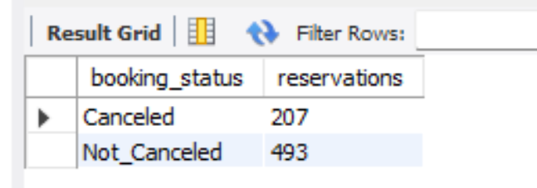
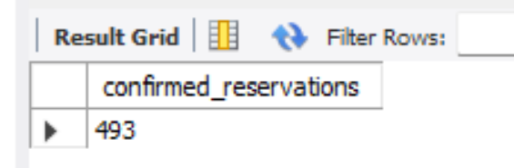
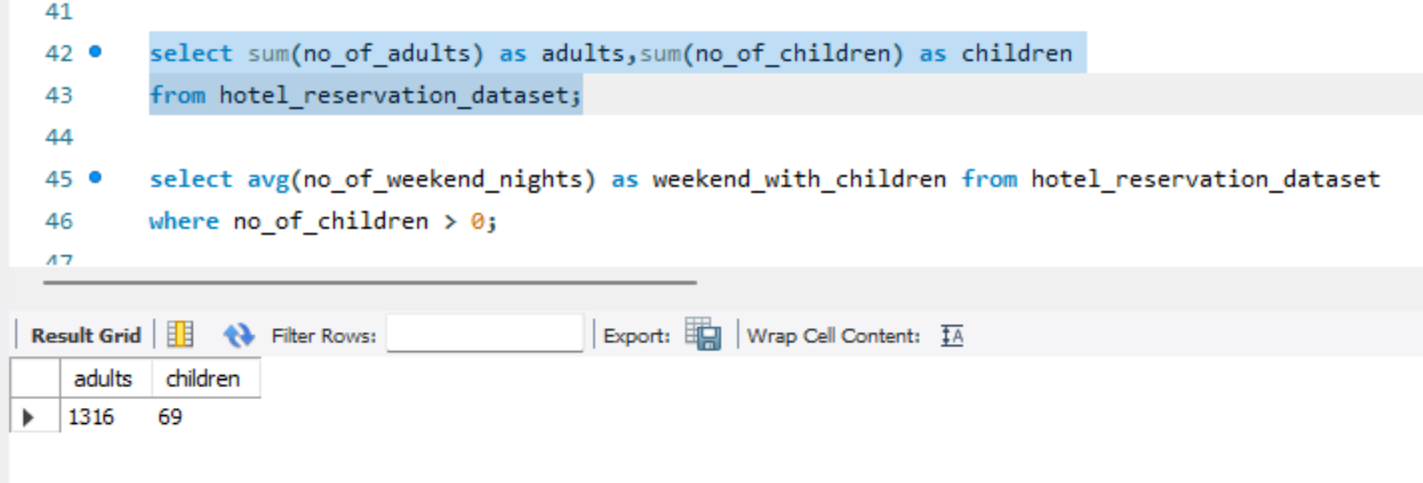
9. How many reservations have a booking status of "Confirmed"?
10. What is the total number of adults and children across all reservations?

Slide 9
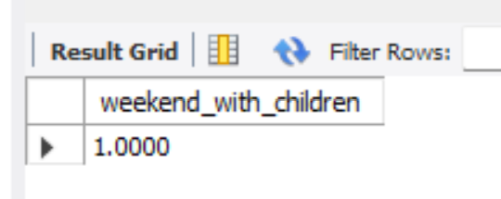
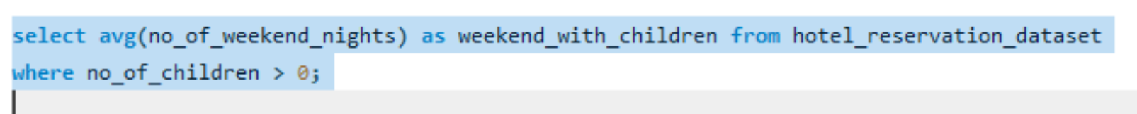
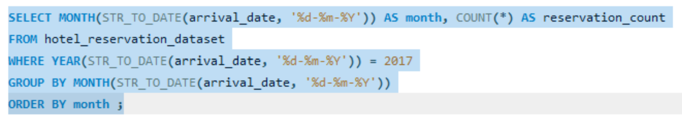
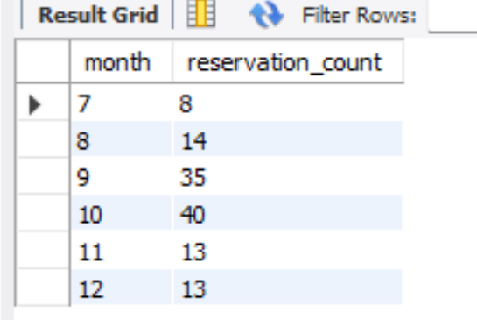
11. What is the average number of weekend nights for reservations involving children?
12. How many reservations were made in each month of the year?

Slide 10
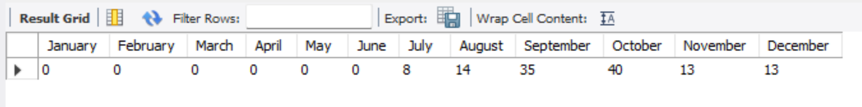
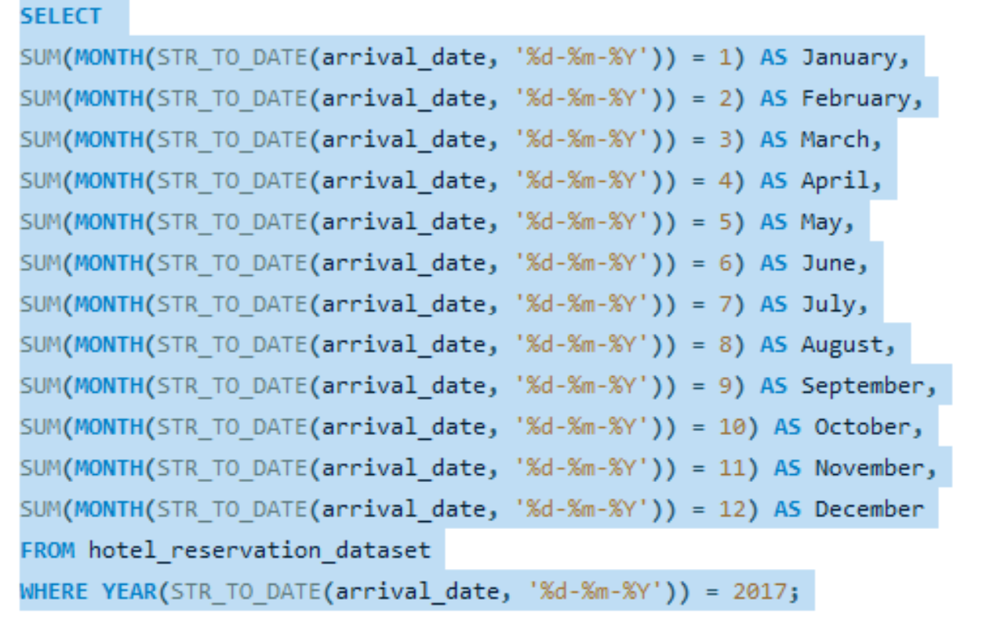
12. How many reservations were made in each month of the year?

Slide 11
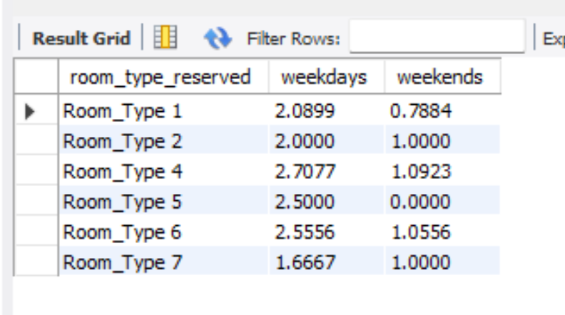
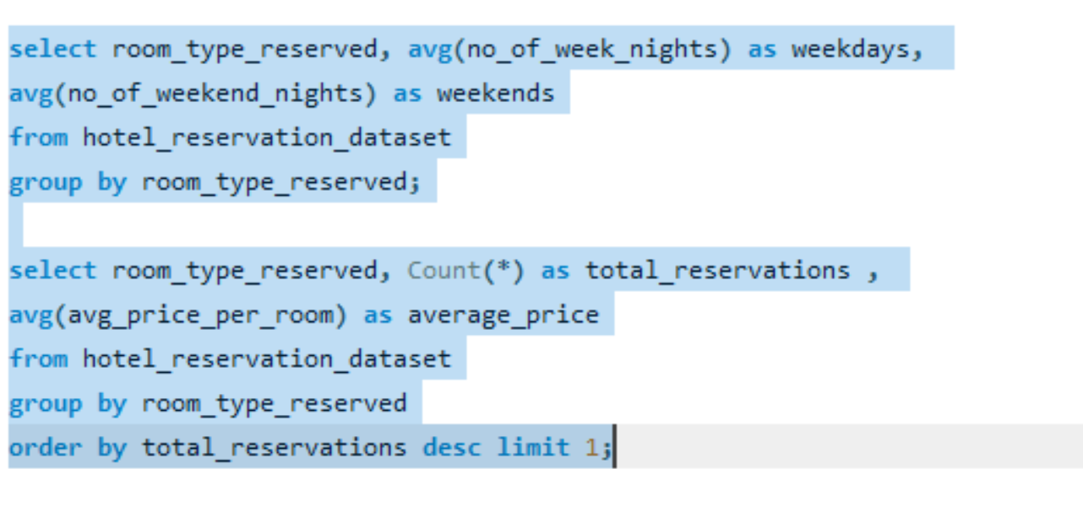
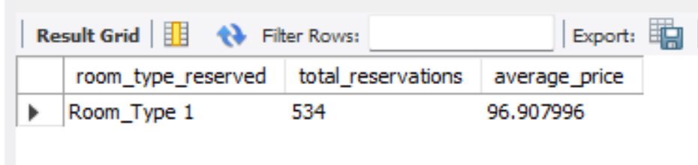
13. What is the average number of nights (both weekend and weekday) spent by guests for each room
type?
14. For reservations involving children, what is the most common room type, and what is the average
price for that room type?

Slide 12
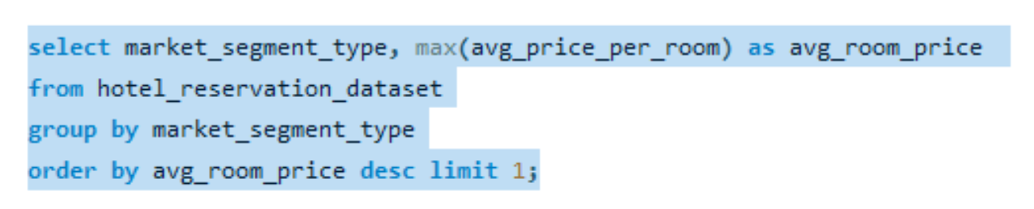
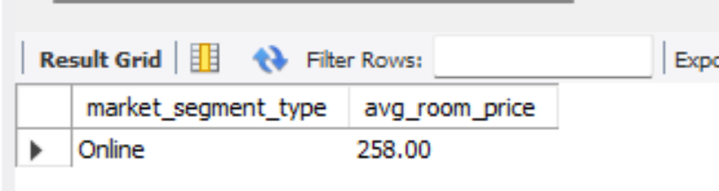
15.Find the market segment type that generates the highest average price per room

Slide 13
Thank you
Made by Aya Ahmed Mostafa Ali

